Slide 1

PRIORITY BASED TASK SCHEDULING FOR HEALTHCARE IOT USING EDGE COMPUTING
23CSE362 Edge Computing
Review 1
24_HeartAttack
Team Members:
CB.SC.U4CSE23443 : SIDHARTH S NAIR
CB.SC.U4CSE23448 : SRIJA K
CB.SC.U4CSE23449 : SUHAS NETHI
CB.SC.U4CSE23465 : SISTHICK S

Slide 2

INTRODUCTION
Tech in healthare
Real-time patient monitoring -> essential in modern healthcare
Medical emergencies need fast local decisions (almost instantaneous)
Delays in processing can lead to fatal consequences.
Latency → issue in client-server & central cloud based systems

Slide 3

EDGE ?
Definition:
Edge computing is a computing paradigm where data processing and storage are performed at or near the data source (the "edge" of the network), rather than in a centralized data center or cloud.
Typically near the data source, such as sensors, devices, or users
Why better?
Edge nodes reduce latency
IoT devices are resource-constrained (low CPU, limited power)
Solves bandwidth overload, energy waste, latency
Allows for instantaneous response to critical data

Slide 4

PROBLEM STATEMENT
“ Prioritize and schedule continuously incoming healthcare tasks on edge nodes based on urgency “
Continuously incoming tasks/data from sensor layer
Dynamic assigning of priority to each of the task based on urgency
Scheduling tasks in edge or cloud layers based on priority specifications
Execute the tasks and make results available to the doctor
Source Material: Journal of King Saud University – Computer and Information Sciences

Slide 5

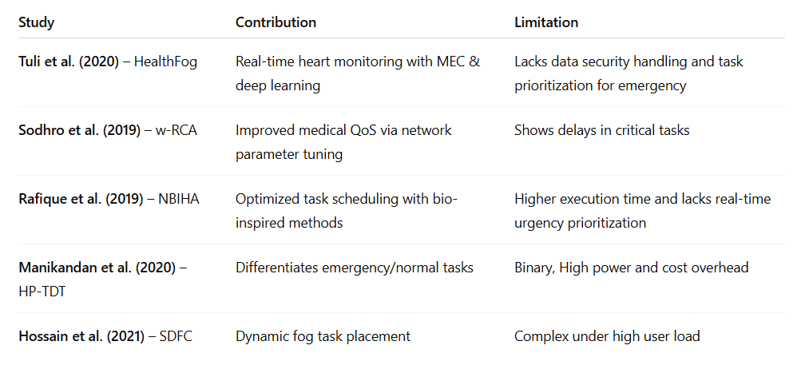
STATE OF THE ART

Slide 6

IMPLEMENTATION STRATEGY
iFogSim2 simulation (Java based simulator)
Simulated devices - sensors, actuators, edge nodes, a cloud interface
Simulated environment includes different types of sensors (Heart-rate monitor, Blood pressure detector, Body Temperature sensor and Glucose level detector) and alarms which are connected to edge nodes (Hospital Workstations) and a cloud interface for offloading tasks
Metrics to improve - latency & execution time

Slide 7
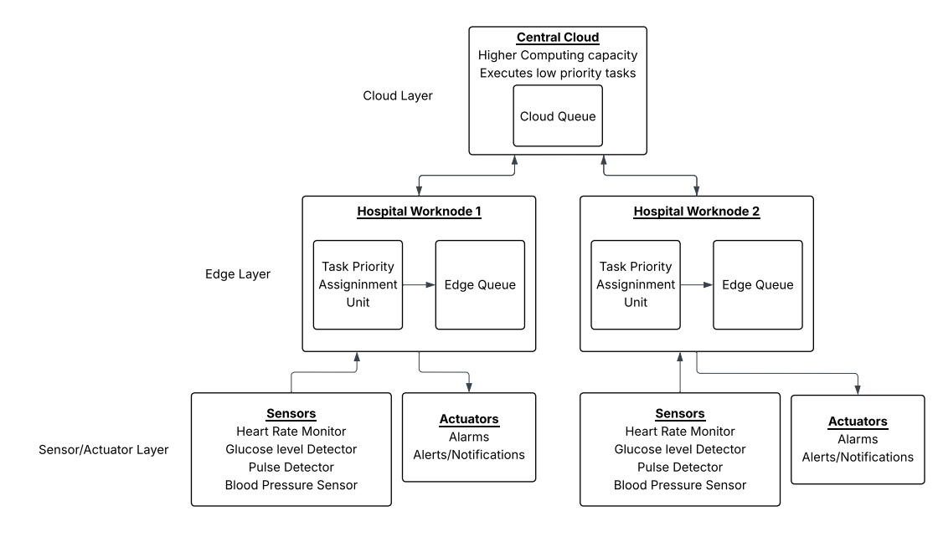
ARCHITECTURE DIAGRAM

Slide 8


TASK PRIORITY & SCHEDULING
Priority Formula:
ub = upper bound of normal range
lb = lower bound of normal range
hpt = given health parameter value
K = priority constant

Slide 9
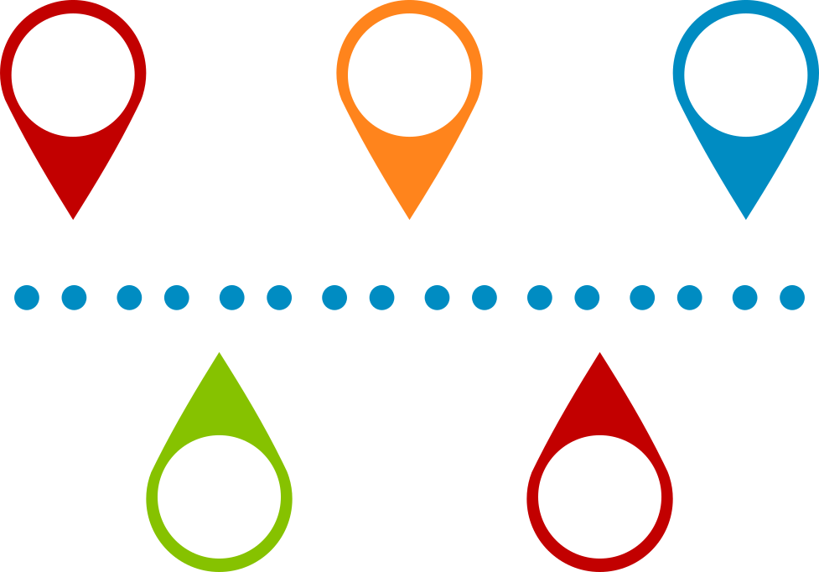
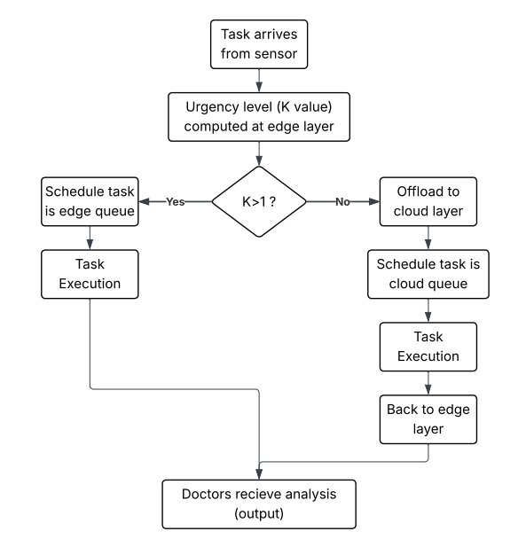
FLOW EXPLANATION

Slide 10
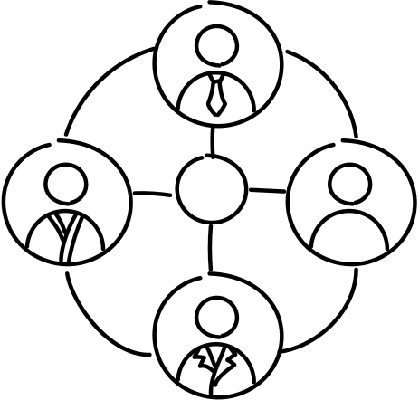
TASK SPLIT
Srija K
Set up iFogSim2 in Eclipse/IDE
Create base simulation environment (cloud, edge, sensors, actuators)
Model healthcare devices (e.g., HR monitor, thermometer)
Simulate task generation at regular intervals
Sisthick S
Integrate priority-based task placement and scheduling (based on K value)
Estimate latency and execution times
Implement logic to sort tasks in queues based on descending K
Sidharth S Nair
Implement the urgency level calculation (K) based on the paper’s formula
Write function to assign K, tag priority (High/Low) to each Task
Test with different sample sensor values
Suhas Nethi
Record task execution details: timestamp, execution node, K value
Graphical analysis through tests (latency vs number of tasks, edge vs cloud utilization)
Implementation report

Slide 11

CHALLENGES
Avoiding aging ( low priority tasks being indefinitely suspended due to incoming high priority tasks)
Selecting among multiple tasks which have emergency priority levels
Proper offloading mechanisms to schedule tasks to the cloud layer
Security measures to ensure proper functioning during failure of an edge node

Slide 12

THANK YOU
Any Queries ?

